Slide 1
Reinforcement Learning
CCM 2023 Lab #4

Slide 2
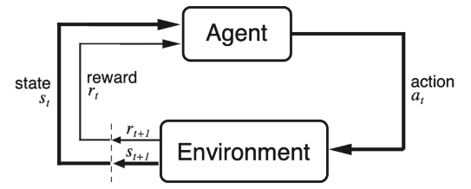
1. Learning to predict (in a static environment)

Slide 3
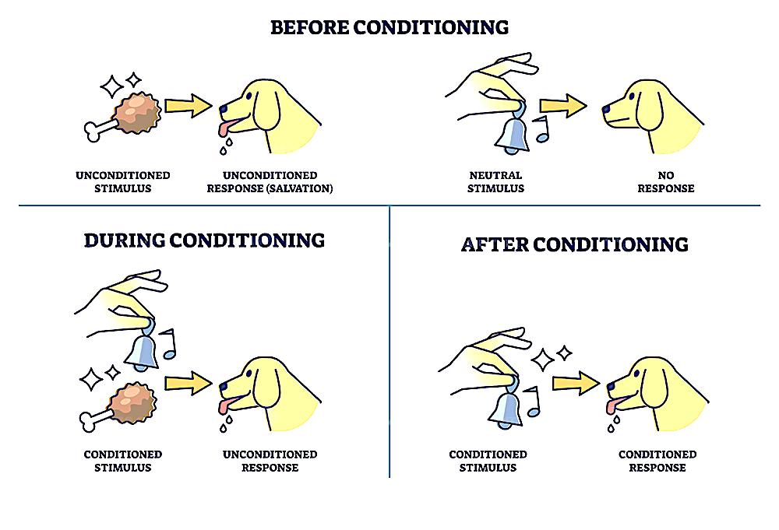
Classic conditioning

Slide 4
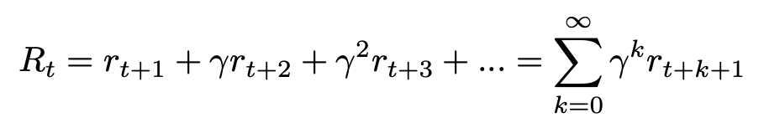

Reward

Slide 5
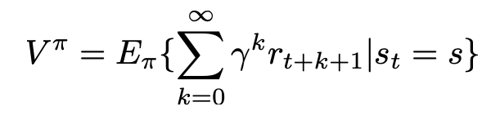

Value
…

Slide 6
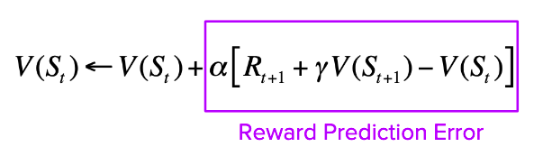
Temporal difference (TD) prediction
𝜹
𝛼 = learning rate
𝛾 = temporal discount rate

Slide 7
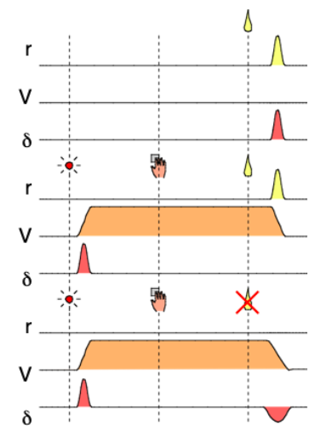
Before Conditioning
After Conditioning
Prediction Error

Slide 8
2. Learning to act (in a static environment)

Slide 9
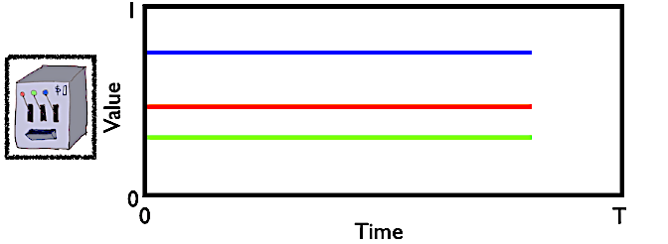
N-armed bandit

Slide 10
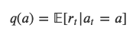
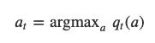
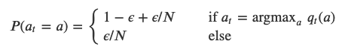
Policy π(s,a)
Action-value function
Greedy policy
𝜖-greedy policy

Slide 11
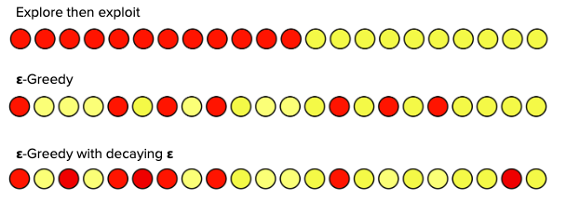
Exploration vs. exploitation

Slide 12
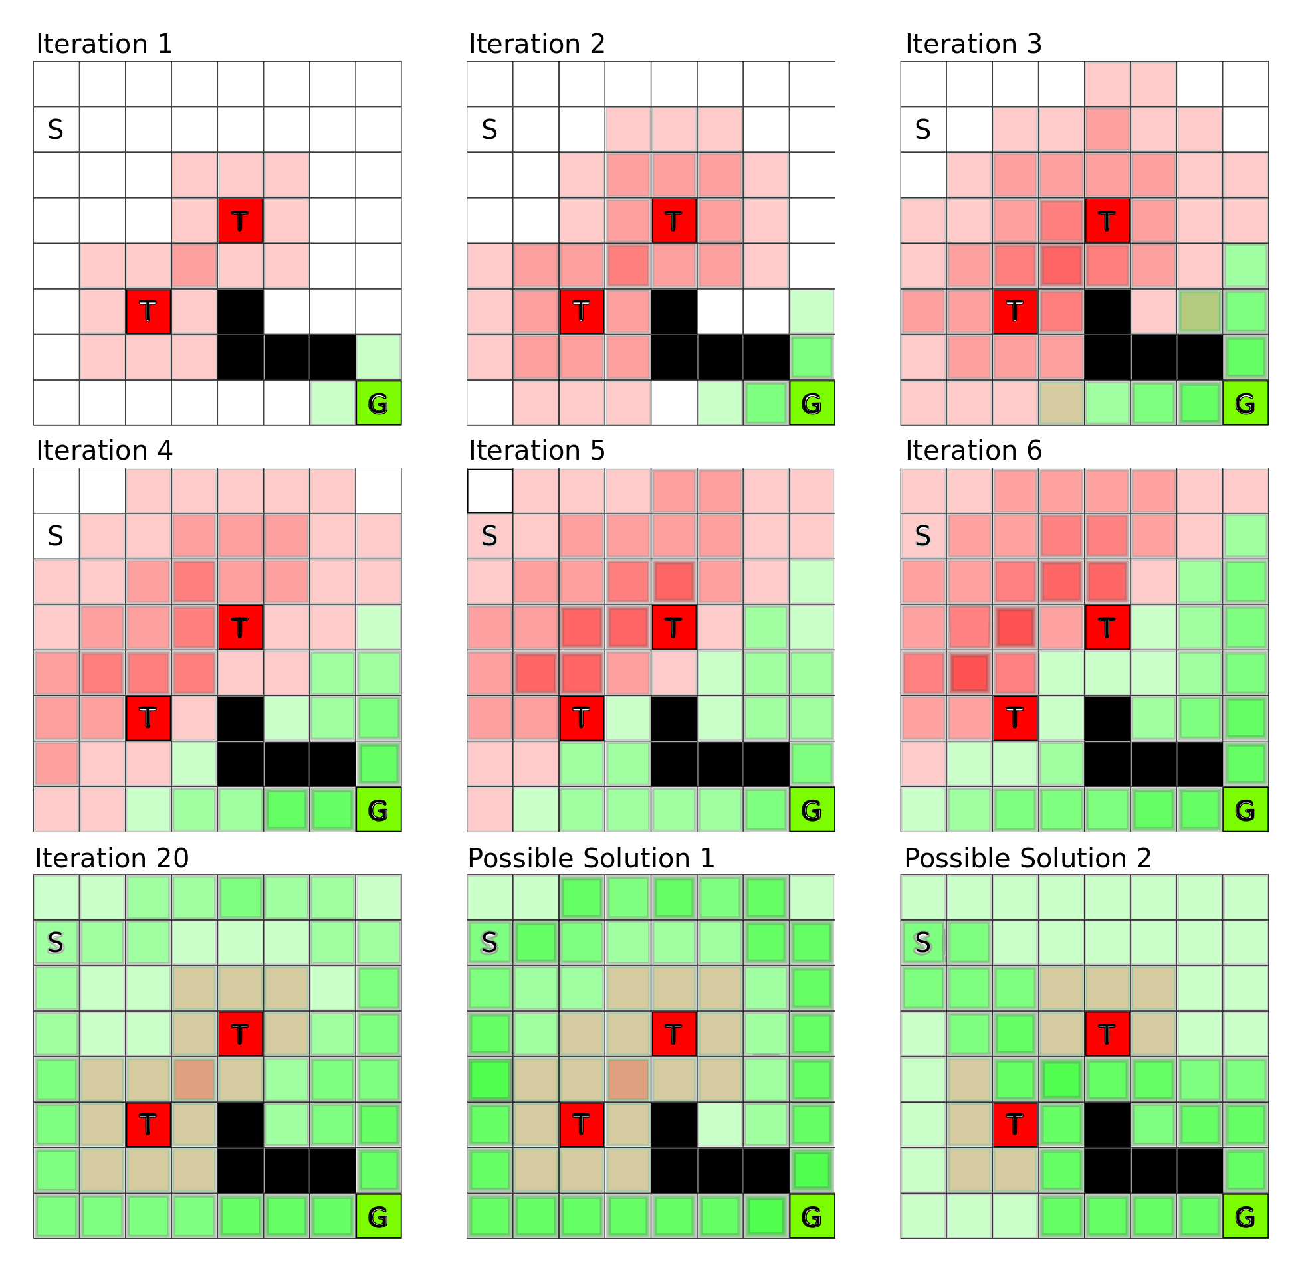
3. Grid world (dynamic environment)

Slide 13
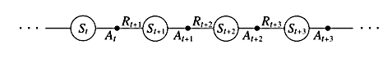
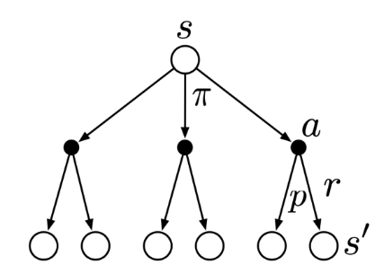
Markov decision process
In a sequential decision problem, the actions executed in one state not only may lead to immediate rewards but may also affect the states experienced next. Each individual action may therefore affect all future rewards. Thus, making decisions in this setting requires considering each action in terms of their expected cumulative future reward.
Notes:
Cumulative probabilities of state action pairs that lead to reward

Slide 14
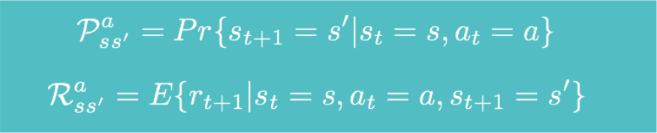
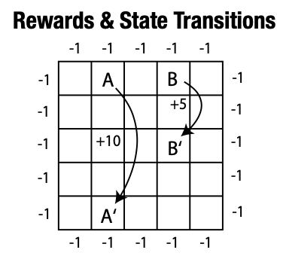
Environment

Slide 15
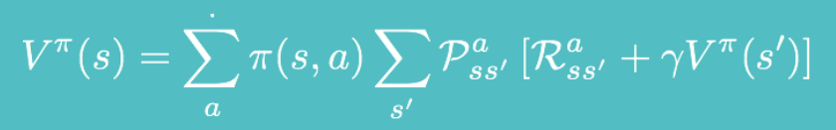
Bellman equation
Find the optimal solution that maximizes cumulative reward.

Slide 16
Different possible solutions
Dynamic programming
Solve a system of equations
Monte Carlo
Run simulations
TD methods
Make predictions

Slide 17
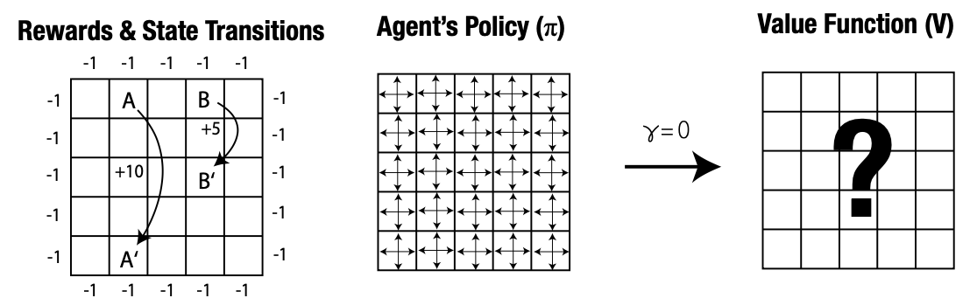
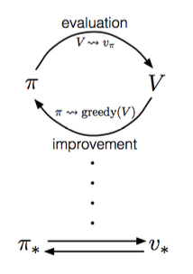
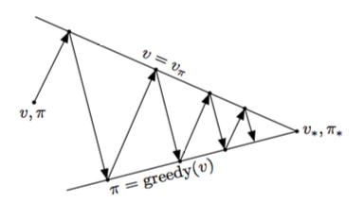
Policy Iteration (a.k.a. dynamic programming)

Slide 18
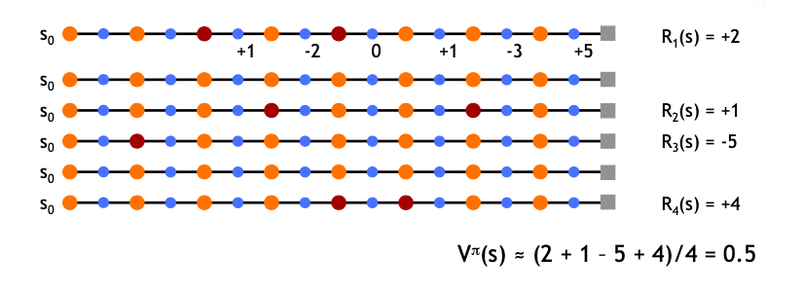




First-Visit Monte Carlo (simulations)
1
2
3
4

Slide 19
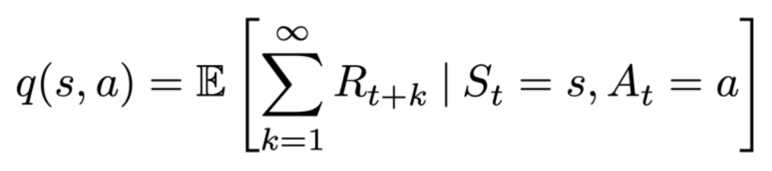
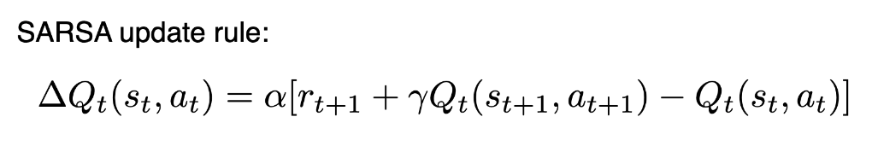
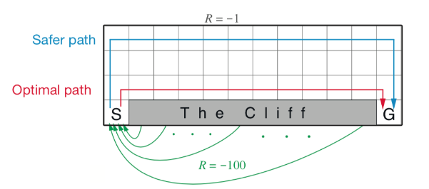
TD–Methods: SARSA (on-policy)

Slide 20
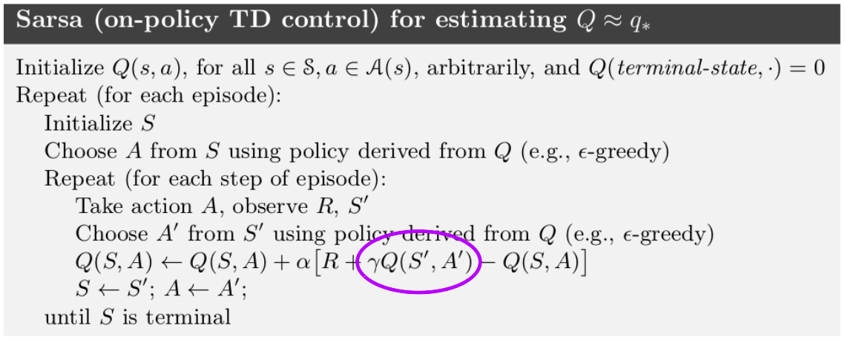
TD–Methods: SARSA (on-policy)

Slide 21
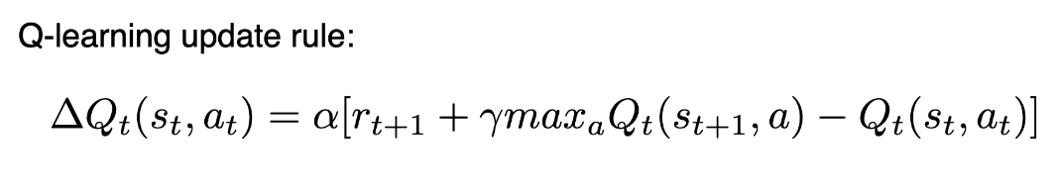
TD-Methods: Q-learning (off-policy)

Slide 22
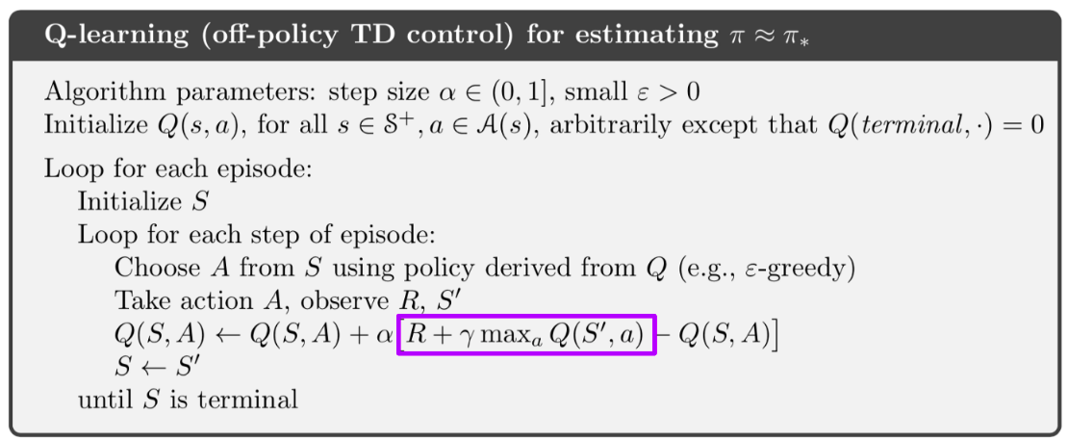
TD-Methods: Q-learning (off-policy)

Slide 23
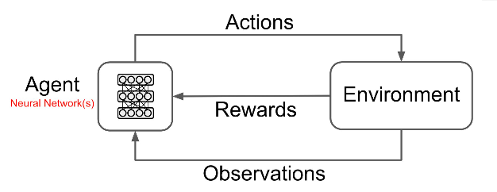
Deep Q-Learning

Slide 24
Deep Q-learning (spatial navigation)
https://cs.stanford.edu/people/karpathy/convnetjs/demo/rldemo.html

Slide 25
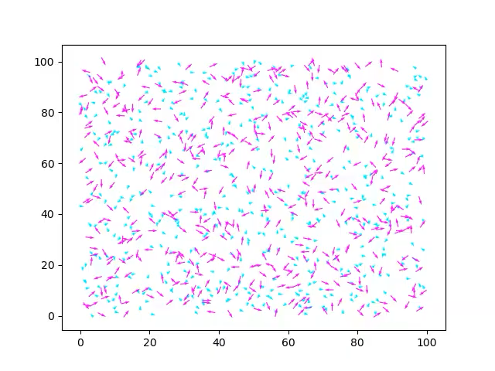
Deep Q-learning (predator-prey multi-agent)
https://github.com/kayuksel/multi-rl-crowd-sim

